Slide 1

SOC 218
Lecture 6-chapters 10 & 11
These slides contain one short-answer essay. This item appears in red

Slide 2
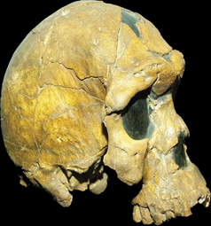
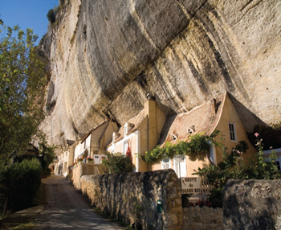
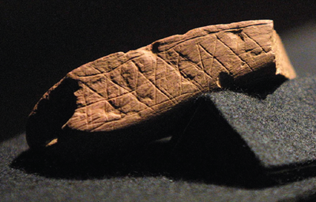
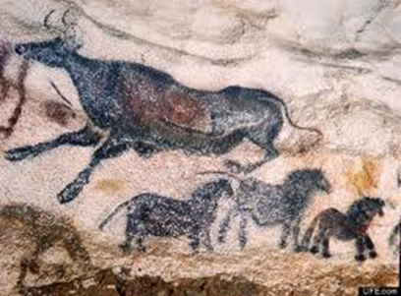
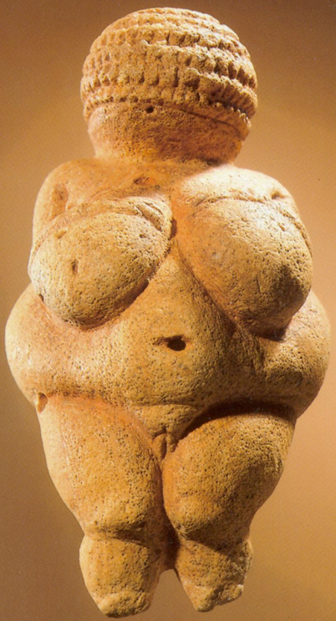
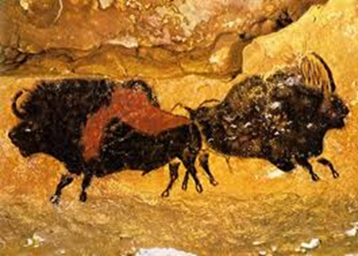
Anatomically Modern Humans and Behavioral Modernity
AMH’s arrive, 200k b.p.
  Discovered in Ethiopia, 1967
    Additional skulls discovered in 1997 near village of Hetro in Ethiopia, dated to exist 195k b.p.
    Earlier discoveries in Europe of specimens dated later than the skulls found in Africa, called Cro-Magnon
      Rock shelters in France made by early AMH’s
Symbolic culture arrives, 164k b.p.
  Discovered in South Africa, 2007
    Many more artifacts with later dates discovered earlier in Europe and the Middle East
      Venus of Willendorf, Austria 30k to 22k b.p.
      Cave paintings at Lascaux, France 20k b.p.
Multi-generational families
  45k b.p. ratio of adults to children grew rapidly
    Wear on the molars indicates age of specimen
    Presence of parents and grandparents aided in the transmission of knowledge; hence allowing culture to flourish

Slide 3
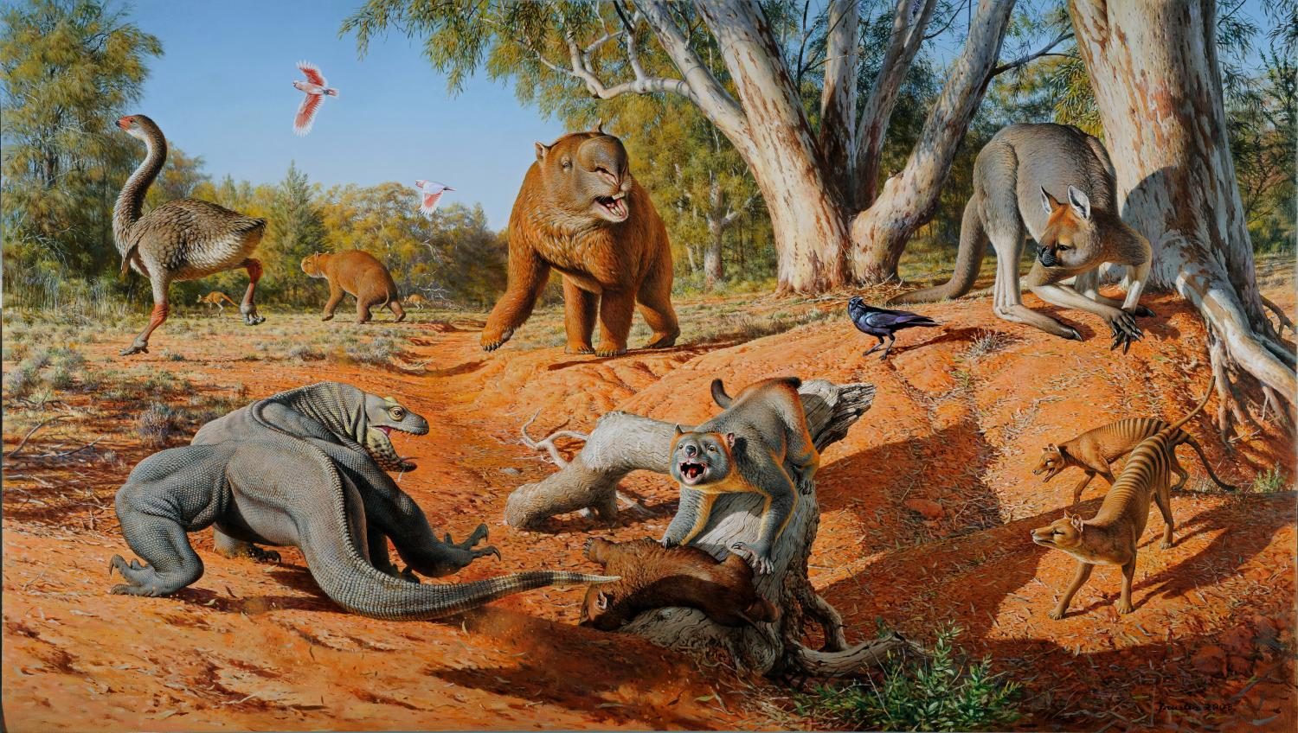
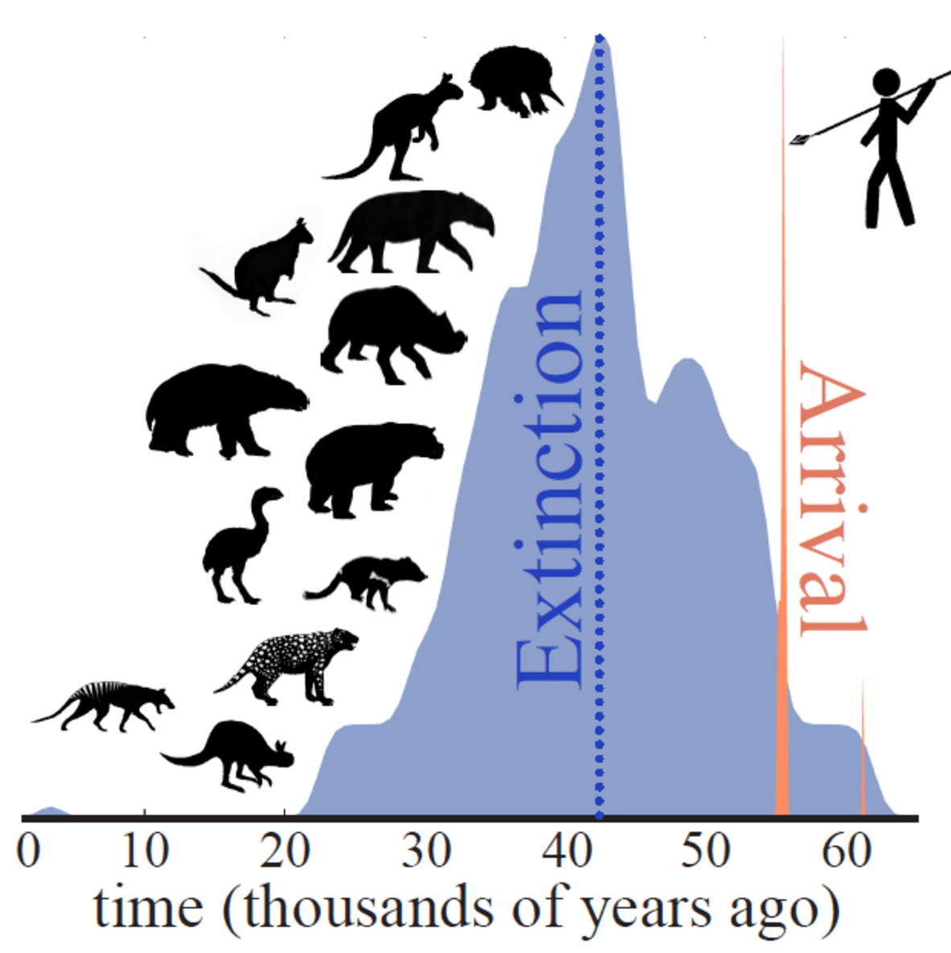
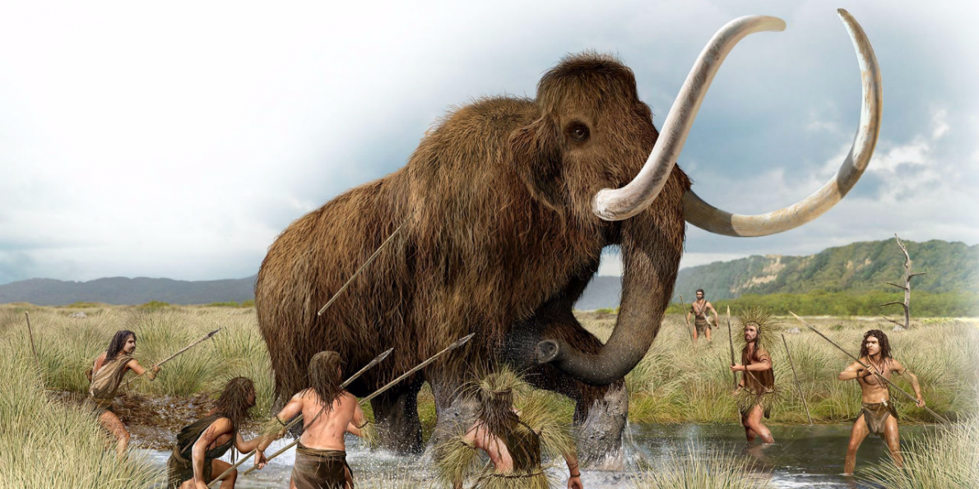
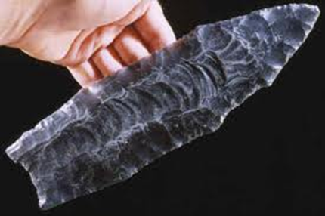
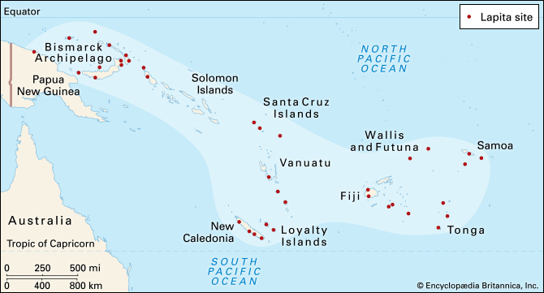
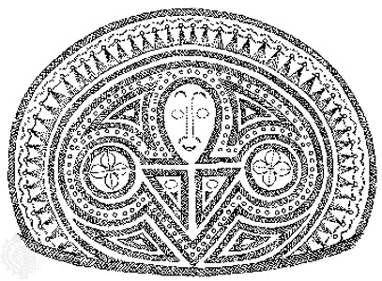
Human Expansion out of Africa (see link)
Settling Australia
  Asia-Australia land-bridge; Sahul
    50k b.p., land connected Australia, Tasmania, & New Guinea
    8k b.p., glaciers retreat, trapping inhabitants
    Mega-fauna go extinct shortly thereafter
Settling the Americas
  Asia-American land-bridge; Beringia
    18k b.p. humans enter North America
    Tracking woolly mammoth
    Clovis tradition: 11k to 12k b.p.
Peopling the Pacific
  Canoeing to populate Polynesian islands
    19k b.p. humans settle the island Tonga
    Lapita pottery characteristic of ancient Polynesia

Slide 4
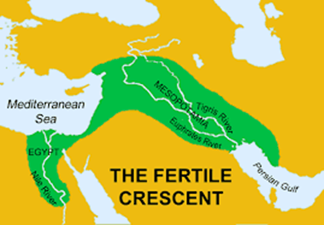
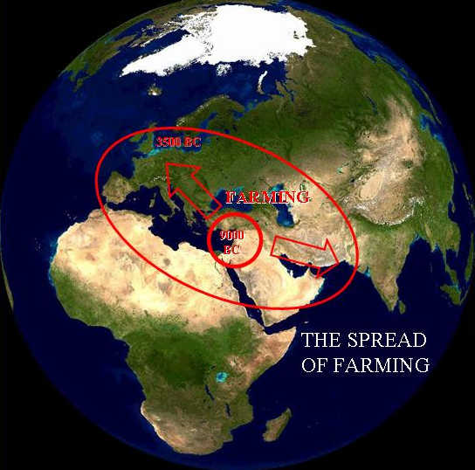
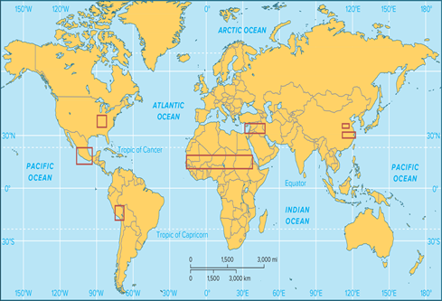
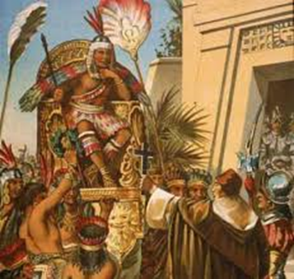
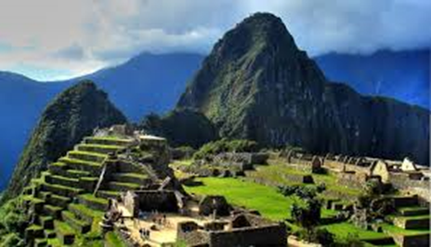
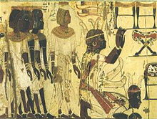
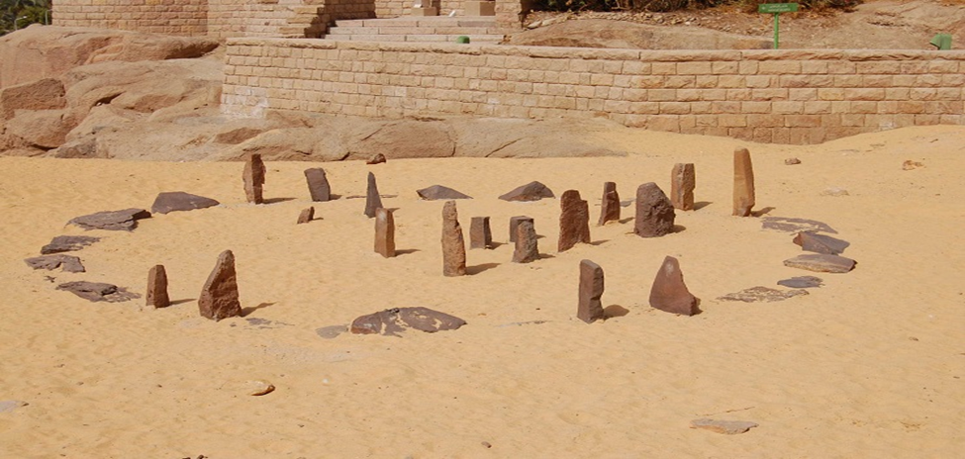
First Farmers of the Neolithic
Broad spectrum revolution, 15k b.p.
  Did not happen everywhere or at the same time
  Unequal distributions of indigenous and domesticatable species
Locations of first farmers
  Fertile Crescent & “Hilly Flanks” (Iraq, Iran, Syria)
    wheat, barely goats, sheep, horses, cattle
    Natufians: foraging to farming , climate changes ~11k b.p.
  China
    chickens, ducks, rice, dogs
    Chinese Empires
  Meso-America (Mexico)
    maize, beans, turkeys
    Mayan Kingdoms
  Andes Mountains (South America)
    potatoes, pigs, llamas
    Inca Empire
  Eastern United States
    sunflower, squash, marsh elder
  Africa
    sorghum, millet, rice
    Nubian culture

Slide 5
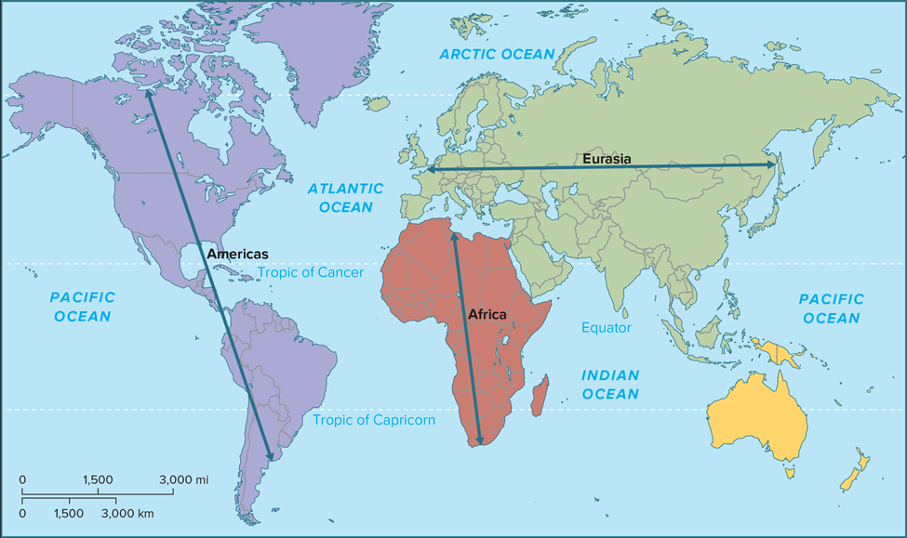
Farming and its spread
Domestication (important factors)
  Planting & Storage
    Taro root in tropic zones vs. wheat in dry and temperate zones
  Temperament of animals
    Buffalo vs. Cattle; Horses vs. Zebras
  Diet
    Carnivores vs. Herbivores
  Breeding cycles
    Elephants vs. Horse
      Few new domesticated plants and animals since the ancient world, 4k b.p.
Geographic limitations of farming
  Same lines of latitude: similar climate & vegetation; same amount of day light
    Europe vs. The Americas
    Africa vs Asia
  East-West Axis vs. North-South Axis
    Diffusion of farming much easier along a east-west axis

Slide 6
Cost and Benefits of Farming vs. Forging
Benefits
Costs
Food Surplus (see link)
  Population size increases
    Shorter birthing intervals for farmers (2 yrs) vs. hunter-gathers (4yrs)
    Settlements and homes were established: no longer nomadic
Beasts of Burden
  Animals used to drive plows and carry loads
    Replaces need for human labor and creates the potential for even more food to be produced
Specialization/divisions of labor
  Food production became a specialized task; allows others to concentrate on improving technology and inventing
Literacy (reading and writing)
  Invented, independently, twice
    Cuneiform in Ancient Iraq, 5k b.p.
      responsible for all other forms of writing on the Eurasian continent, from Chinese characters to Egyptian hieroglyphics
    Glyphs in Ancient Mexico, 2.6k b.p.
      Writing system of the Maya
Health and disease (see link)
  The farming of livestock (cows, sheep, pigs, ducks, chickens) allowed for the transfer of the flu, measles, small pox from animals to humans
    Resistance builds up after many generations of working with livestock
Slavery
  Emerged in every society large enough to subjugate smaller neighboring populations
    Humans used as additional beasts of burden
    Over 1/3 of the populations of ancient Greece and Rome were slaves
Warfare
  Specialization of a warrior class
    Governments now able to project power and achieve unprecedented death tolls
Environmental degradation
  Global warming and species loss

Slide 7
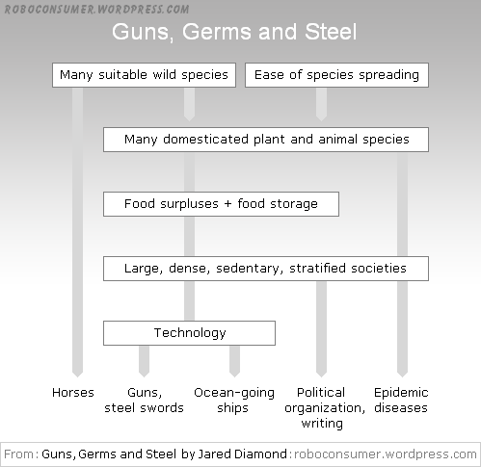
Guns, Germs, and Steel (Documentary) (see link)
Short-answer essay 8: Many scholars consider Diamond’s explanation of global inequality as simplistic, ignoring the role of culture (e.g., politics and religion--see link). Are there not countries in the world that are either rich or poor for reasons that cannot simply be traced back to differences in natural resources? Consider, for example, countries in Africa that have natural resources, such as oil and minerals, but remain poor. What do you make of this resource conundrum?
  Post your answer on Moodle [150-250 words]
  Respond to a post that you think is especially interesting and say why [50 to 100 words]

